Slide 1
Step 1 (continued): Needs Assessment Methodologies

Slide 2
Outline
Review different needs assessment methodologies:
Environmental scans / situation analysis
Surveys
Qualitative methods:
Key information interviews
Focus group discussions
Network mapping
Organizational assessment: Knowledge Management Index
Data analysis and synthesis of findings
Dissemination of findings

Slide 3
Why Conduct an Information Needs Assessment?
Understand the current capacity of knowledge management and knowledge exchange systems in your program.
Identify gaps in information sharing, knowledge exchange, and knowledge management
Identify key stakeholders, networks, and existing resources
Notes:
This can provide the foundation for evidence-based and needs-driven programs and policies.

Slide 4
Potential Needs Assessment Questions
What information and knowledge do health professionals need to do their jobs that they currently do not have access to, or have trouble finding?
What sources of information do they use?
How do they store, transfer and share information?
What systems of formal/informal communication are used to exchange information among different levels of the health care system?
What are the barriers to accessing, sharing and using health information?
What is the role of professional networks and associations in knowledge exchange for health?
Which communication channels and formats are preferred?

Slide 5
Methodologies

Slide 6
Which methodologies to use?
Environment scans/situation analysis
Surveys
Qualitative methods:
Key Informant Interviews
Focus Group Discussions
Network Mapping
Organizational Assessment: Knowledge Management Index

Slide 7
Environment Scan – What It Is
The process of seeking, collecting, and analyzing information to inform a program, research study, or other activity
Conducted at the beginning of a project or activity to inform its direction/course
Usually conducted using existing information
Notes:
The process of seeking, collecting, and analyzing information to inform a program, research study, or other activity conducted at the beginning of a project or activity to inform its direction/course
Usually conducted using existing information
Know what you don’t know
How it is done: Purposely seek, collect, and analyzing information
How do people currently share information? Do some types of people share information more frequently? (Technical staff sharing peer-reviewed articles) Do groups of people share information differently? (Using WhatsApp vs. personal email vs. listserve emails). Blogs?
What communication channels, tools, and technologies exist within your program? Is there an intranet that all staff members have access to? Is there a program library? Do you need to loop in providers?
Determine intended audience for KM strategy: Who should be sharing information? Who should be using knowledge? Are they the same? Should all knowledge be intended for all those involved? M&E specialists working in the field office? Or is it the providers that your program has trained?
Catalogue existing networks: Do program staff already belong to knowledge networks (e.g. IBP, K4Health, global listserves)? Are there meetings or events where people get together regularly to share information (e.g. conferences, quarterly review meetings, partners meetings)?
Activity! Fill out the Appendix B sheet using your program as the example. We will discuss your answers in the group.

Slide 8
Environment Scan – How to Conduct It
Define key areas of focus
Define sources of information
Online databases
Search engines
Project/organization websites
Listservs
Interviews
Define search terms, strategies, interview guide, etc.
Collect the information, identify common themes, synthesize findings
Notes:
Due to the large amount of information that might be available on a given topic, it is best to begin an environment scan by defining key areas of focus and/or research questions.
Sources of information could span online databases and bibliographies, eg, PubMed, POPLINE, online search engines, eg, Google, Google Scholar, listservs, interviews with key informants

Slide 9
Environment Scan – Strengths and Limits
Strengths
Combining information from various sources can provide information about trends
Can be fast and relatively inexpensive
Can be conducted from anywhere
Limitations
Lack of specificity
Information may not be relevant for all contexts

Slide 10
Survey – What It Is
Structured questionnaire that includes closed- and open-ended questions
Can include questions about health information needs, preferred sources of health information, information-sharing preferences, and use of information communication technology
Notes:
Usually quantitative in nature but can include open-ended questions to elicit qualitative information.

Slide 11
Survey – How to Conduct It
Can be administered in person, over the phone, or online
Pretest the questions
For online surveys, use recognized survey platforms (e.g. SurveyMonkey, Google Forms, etc.)
Use multiple strategies to send out the survey to increase response rates
Notes:
• Use recognized survey platforms (e.g. SurveyMonkey, Google Forms, etc.) - this will depend on the target population for the survey
• Pretest the questions - it is critical to make sure that the questions are understood by participants
• Use multiple strategies to increase response rates - for example, develop a blog entry, send reminder emails, etc.

Slide 12
Survey – Strengths and Limits
Strengths
Inexpensive
Data can be collected in a short period of time
Provide accurate data
Protect the anonymity of participants
Can offer access to a wide range of respondents
Online programs provide existing platforms
Limitations
Online surveys only reach respondents with reliable access to the Internet
Sampling frame is often not available or controllable
Notes:
Response rate - Often researchers cannot know exactly how many people receive the survey announcement. As a result, the actual response rate is unknown.
Such limitations could potentially result in a biased sample and consequently lead to low data quality.

Slide 13
Key Informant Interview (KII) – What It Is
The process of collecting qualitative in-depth information from an individual who is particularly knowledgeable about the topic of interest
Purpose is to speak with a wide range of people who have access to the desired information

Slide 14
KII – How to Conduct It
Choose a qualified interviewer
Identify suitable key informants
Develop interview guide with primarily open-ended questions
Hold the interview in a comfortable location
Record and transcribe the interviews, or else take detailed notes during the interview
Let the respondent do most of the talking
Review the notes and contact the respondent for clarification if needed
Notes:
Choose a qualified interviewer. Look for someone who is friendly and a good listener, understands local customs, and inspires confidence and trust.
Identify suitable key informants. Make sure key informants have a good understanding of the issue that the researchers want to explore
Include primarily open-ended questions in the interview. Develop an interview guide well in advance of the interview to ensure that all areas of interest are covered.
Hold the interview in a comfortable location. Try to put the respondent at ease.
Record and transcribe the interviews. Be sure to ask the respondents for permission to record their interviews.
Let the respondent do most of the talking. Interviewers should be active listeners and show interest in the respondents’ opinions
Take measures to reduce bias in the interviews. Encourage interviewers to avoid judgmental tones and leading questions
After the interviews, review the notes. If the interviewer did not understand something, be sure to contact the respondent for clarification

Slide 15
KII – Strengths and Limits
Strengths
Researchers can obtain detailed (often candid) information from people with diverse backgrounds/opinions
Requires few resources, allowing researchers to gather rich detail on a topic quickly and easily
Interviewer can clarify the meaning of questions
Limitations
May be difficult to find the best key informants
Often challenging to schedule interviews around busy schedules
Large sample may be needed to represent a diverse group with various points of view
Require a trained interviewer

Slide 16
Focus Group Discussion (FGD) – What It Is
A method of gathering information about a particular topic by interviewing a group of people directly affected by the issue
FGDs differ from individual interviews, as they allow for interaction among all the members of the group

Slide 17
FGD – How to Conduct It
Consider the composition of the FGD
Keep the group size to 8-10 participants
Try to keep the time to less than 2 hours
Have a trained moderator
Develop a facilitator’s guide with open-ended questions; avoid leading questions
Be comfortable with silence
Probe for more information
Hold the FGD at a neutral and easily accessible location
Record and transcribe the discussion if possible, or else take detailed notes
Notes:
Carefully consider the composition of your FGD. Most focus group discussions include participants who have common characteristics, related to the topic of study (for example, health officials). However, researchers may choose to include a more diverse group in the FGD, depending on research goals. While a homogeneous group may encourage participants to contribute to the conversation, as they may feel that they are talking among their peers, it may be important to contrast viewpoints from different sectors of the population.
Keep the group size to 8 to10 participants. In most cases, this size is enough to stimulate discussion among participants while still being manageable for the moderator.
Try to keep the time to less than two hours. Most FGDs are between one to two hours. If longer, consider giving participants a break.
Have a trained moderator. It is crucial that FGD moderators are adequately trained, as their skills in phrasing questions can affect responses and skew results. This can help the discussion remain on-topic. Assistant moderators can take notes and keep track of time.
Hold FGDs at the community level. In order to make sure that invited participants can attend, hold the FGDs where most participants are co-located. The venue should be neutral, private, free from distractions, and easily accessible.
Make sure the facilitator is familiar with the questions beforehand. The FGD moderator should practice questions out loud, know the purpose of each question, and know how much time to spend on each question. Do not stray from the facilitation guide.
Avoid leading questions. Instead, try value-neutral and information-seeking questions. For example, rather than asking, “Does poor quality data impede decision-making in your community?” instead ask, “Can you tell me more about the barriers to using health information for decision-making in your community?”
Be comfortable with silence. Some participants may need additional time to consider the question, so do not rush participation.
Probe for more information. When participants are not providing enough information, ask follow-up questions and try to solicit the information you need.

Slide 18
FGD – Strengths and Limits
Strengths
Capture differences in perspectives
Can uncover information about sensitive topics more easily
Can shed light on factors influencing behavior or opinions
Opportunity to learn about the interactions among different members of the group
Limitations
Take time to plan and conduct
Require a trained facilitator
Can be costly
Risk of peer pressure
Small sample size – may not accurately represent the community

Slide 19
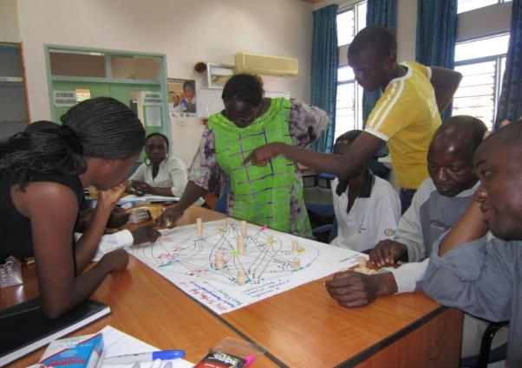
Network Mapping (Net-Map) – What It Is
Participatory social mapping tool
Created by individual or group
Respondents work with interviewers to address a key question and create a network map of actors
Photo © 2011, Natalie Campbell, Courtesy of MSH
Additional Resource Net-Map Toolbox (by Eva Schiffer)
https://netmap.wordpress.com/

Slide 20
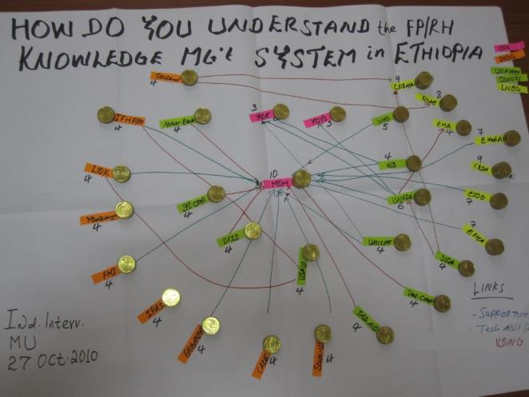
Net-Map – How to Conduct It
Participants list relevant actors and examine links between them
Participants add “influence towers” to represent power and influence of various actors
The individual (or group) then discusses the goals of each actor
Photo © 2010, Ethiopia Research Team

Slide 21
Net-Map – Strengths and Limits
Strengths
Low-tech and low-cost
Can be used with a variety of stakeholders
Visual representation of a network
Good way to understand flow of information– bottlenecks & opportunities
Researchers gain information they may not have gotten through an interview
Limitations
Time, scheduling
Harder to use in larger networks (with more than ~50 actors)
Facilitators need training
Simple to conduct, but analysis may require expensive software

Slide 22
KM Index for Global Health – What It Is
Assesses an organization's current implementation and capacity for KM initiatives
When to use the index:
As a baseline assessment to inform the creation of project activities meant to enhance KM capacity
As an endline measure to assess changes in KM capacity and implementation of KM initiatives overtime
As a monitoring tool to assess organizational level KM strengths, weaknesses and opportunities for improvement
Notes:
The findings that emerge from the KM Index can be used to identify potential opportunities for improvement in implementing KM and to develop an action plan to strengthen KM capacity.

Slide 23
Components of the KM Index Tool
Four domains with a series of key KM elements in each domain:
Organizational Structure – 7 KM Elements
Learning Opportunities – 5 KM Elements
Internal KM Culture – 10 KM Elements
KM for Global Health – 6 KM Elements
Uses quantitative and qualitative data:
Qualitative: participant responses to the questions under each domain.
Quantitative: tallied from the number of KM elements an organization is practicing; called the “KM Index Number”
Notes:
Example KM Elements:
Organizational structure: Does your organization have a definition of KM? Does your organization have a KM strategy?
Learning opportunities: Do new staff receive an orientation? Do you offer internal training? Do staff have the opportunity to attend external training?
Internal KM culture: Are staff encouraged to seek out new ideas? Do employees receive incentives for sharing information?
KM for global health: Does your organization consistently seek out the latest technical guidelines? Are employees encouraged to join external professional associations?
KM Index Number:
Based on the responses to the KM element questions, the facilitator will provide a 1 or 0 for each KM element under the domain.
A score of 1 indicates and organization is using that element.
A score of 0 indicates an organization is not using that element and/or not using it to its full potential.
For example, if an organization is only using 3 out of 7 KM elements under Organizational Structure, their KM Index Number will be 3 for Organizational Structure.

Slide 24
KM Index – How to Administer It
Meant to be administered by a Facilitator in a small group setting.
Facilitator poses questions from the KM Index to the group for discussion.
Open-ended responses from the discussion are used to determine how well a KM element is being practiced and potential areas for improvement.
The Facilitator reports the findings and works with the organization to create an action plan based on the findings.
Notes:
Each domain and/or KM element may not be relevant to every organization. The Facilitator and organization should discuss which domains, if not all, will be included.
Results should be shared and analyzed in coordination with the KM champion at the organization to ensure the presentation of the findings and the action plan are appropriate.

Slide 25
KM Index – Strengths and Limits
Strengths
Capture perspectives at the organizational and intra-organizational (e.g., working groups, professional networks) level
Capture differences in perspectives
Interviewer can clarify the meaning of questions
Limitations
Requires a trained interviewer who is objective and can balance different perspectives from participants
May bring up sensitive internal issues that may make some of the participants uncomfortable to discuss

Slide 26
Data Analysis

Slide 27
Needs Assessment Data Analysis
Use an appropriate method or software to analyze the data
Quantitative data: Excel, STATA, SPSS, etc. to look at frequencies, proportions (percentages), scores, scales, etc.
Qualitative data: Content analysis by coding manually on a spreadsheet (e.g., Excel), etc. or using Atlas.ti, NVivo, Dedoose, other qualitative data analysis software to understand both common or unique opinions, behaviors, and attitudes
Triangulate findings from different sources of data
Examine both similarities and differences across data from various sources
When applicable, stratify data by audience characteristics (e.g., country of work, job type, organization type, years of experience in health technical area, education level, etc.)
Identify common themes and patterns that emerge from data

Slide 28
Synthesizing the Results
Needs assessment report structured similarly to research report, but focused more on programmatic information
Background including project description, gaps in research, justification for conducting needs assessment
Research questions and methods
Findings including participant characteristics. Organize sub-sections based on research questions and/or common themes
Recommendations including implications of key findings to the project. Consider using table formats by using key findings, implications, and recommendations as column headings.
Conclusions including limitations
Notes:
Needs assessment reports are typically structured as research reports or articles. Essential elements usually consist of: Introduction (including key research questions), Methodology (including study design, study setting, recruitment of participants, and data management and analysis, challenges and limitations), Key Findings, Discussion of Findings (including programmatic implications), and Conclusions.

Slide 29
Dissemination of Findings

Slide 30
Disseminating Needs Assessment Findings
Invite stakeholders with a variety of perspectives
Involve an informed moderator
Allow adequate time for explaining the methodology
Offer clear recommendations
Document participant feedback
Develop a follow-up plan
Be realistic
Be aware of sensitive information
Notes:
Regardless of the method used to assess information needs, the findings from those needs assessments should be shared with the relevant stakeholders.
BEFORE THE EVENT:
Invite stakeholders with a variety of perspectives: to fully develop action plans, it can be crucial to involve stakeholders from different levels. You may need to be flexible with timing. Although it is ideal to hold the meeting as soon as possible after the study to capitalize on enthusiasm, it can often be difficult to find a day that works for all invitees and potential speakers (particularly high-level officials).
Involve an informed moderator: He or she can ensure that the presenters stick to the schedule and that the discussion is relevant.
Allow adequate time for explaining the methodology and answering questions fully: Not everyone is familiar with the methods (particularly the qualitative methods) used in needs assessments.
Offer clear recommendations (and perhaps a list of priorities): After presenting the results, make sure to offer recommendations. This makes it easier for funders to support follow-on activities.
Document participant feedback: Use feedback to finalize materials. In order to fully engage participants, distribute a draft report and ensure them that their feedback, questions, and recommendations will be addressed and incorporated into the final report.
Develop a follow-up plan: Make it attainable and specific to the different levels of the needs assessment study, if relevant.
Be realistic: it may take time for action plans to come to fruition. Furthermore, some stakeholders will still need more evidence. Particularly on the donor side, there may be the need for more than just a dissemination workshop—for example, a pilot project or a 5-6 month experiment phase in which study recommendations are implemented—in order to fund follow-on activities.
Be aware of sensitive information: If there is sensitive information in the presentation or discussion, be careful not to document this discussion/disseminate meeting notes widely.
TRAINER NOTE: elaborate on #1 if important to the participants:
# 1: Invite stakeholders with a variety of perspectives: Make sure to include individuals from government agencies, NGOs, donor agencies, religious groups, and other prominent national (and/or regional and community, as appropriate) organizations. Inmost settings, it was easier to schedule a national-level meeting, due to better access to technology and other issues. However, to fully develop action plans, it can be crucial to involve stakeholders from the regional, state, and local levels.
Trainer Note: elaborate on #8 if important to the participants

