Slide 1
Step 2: Design KM Strategy
Notes:
Effective KM interventions must be supported with a well-designed strategy. The goal of Step 2 is to create the strategy for how to improve your health program with knowledge management. This strategy will serve as a roadmap for your KM activities—ensuring that specific gaps in your knowledge needs assessment are addressed, and that milestones, indicators, and activities are tracked. It will also help you stay on track and use your resources effectively.

Slide 2
Objectives
Understand the value of a well-designed KM strategy
Describe the key elements that make up a KM strategy
Understand the added value of a theoretical foundation
Describe how a KM strategy supports organizational and project activities
Explain the qualities of strong KM goals and objectives
Draft a timeline for implementing a KM Strategy
Notes:
NOTE TO TRAINER: This Step in the Training Package will help participants get a sense of the importance of a KM Strategy and consider the key tasks to develop a KM strategy (as outlined in the Building Better Programs Guide):
Determine budget, resources, and timeline for the KM intervention
Consider relevant theoretical frameworks that can guide the KM intervention
Develop a plan by deciding on objectives, audiences, and KM products and approaches.
Bring together relevant stakeholders to launch the KM intervention.
The Training Package will not lead participants in the actual development of a KM Strategy.

Slide 3
KM Strategy to Improve Programs
A well-designed KM strategy should help to effectively manage resources and time to improve your health program.
It will serve as a roadmap for your activities – ensuring that specific gaps in your knowledge needs assessment are addressed, and that activities and milestones are tracked.
Notes:
Ideally you will need several things before you start to develop a KM strategy that was discussed in Step 1: Assess Needs. This includes a needs assessment report, a concise definition of your target audience(s) and the development of achievable and measureable objectives.
You can consider using a SWOT (strengths, weaknesses, opportunities, threats) Analysis to help you organize your thinking and the results coming out of your needs assessment.
NOTE TO TRAINER: There is an optional SWOT exercise included in the KM Training Package. It would take approximately 45 minutes to include in an in-person training session.

Slide 4
Four Steps to Developing a KM Strategy
Develop a plan by deciding on objectives, audiences, and KM products and approaches.
Consider relevant theoretical frameworks that can guide the KM intervention.
Determine budget, resources, and timeline for the KM intervention.
Bring together relevant stakeholders to launch the KM intervention.
Notes:
These are the four sub-steps within Step 2 to designing and developing a KM strategy. I will be going over these very briefly.

Slide 5
Components of a KM Strategy
Alignment with the overall mission of the activity, project, or organization
Supporting stakeholders
Audience(s)
Supporting theory(ies)
KM definition
SMART objectives
Implementation process and staff roles
Budget, timeframe, and human resources
KM approaches
Supporting ICTs
Ensuring Sustainability

Slide 6
Develop a plan by deciding on objectives, audiences, and KM products and approaches

Slide 7
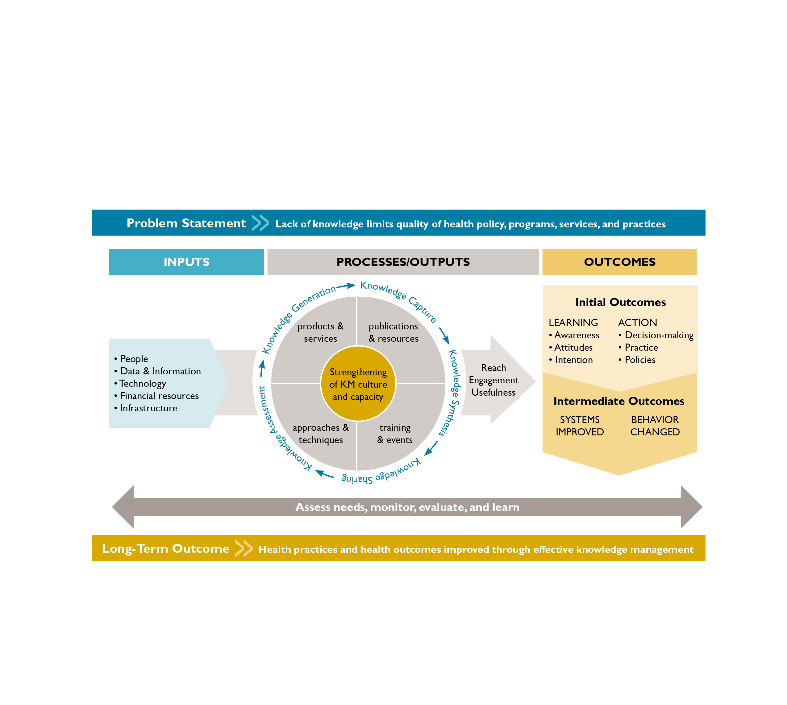
Objectives: On the Way to Your Goal
Notes:
Having clear objectives helps you decide which activities to undertake to effect certain outcomes. While determining your objectives, consider the challenges your needs assessment uncovered at the input, process/output, and outcome stages of the KM for Global Health Logic Model.
If your have completed a needs assessment (as described in Step 1: Assess Needs), revisit it to ensure that your KM objectives are based on actual needs. If you have not, choose no more than three to five KM objectives, and make sure your objectives are SMART: Specific, Measurable, Achievable, Realistic, and Time-bound (CDC, 2009).
Objectives can be at the output level—that is, effecting reach, engagement, or usefulness of your KM products and approaches. For example, your KM objective could be to increase engagement with a knowledge sharing platform, such as an online community of practice, by 30% over a six-month period.
Objectives can also be at the initial outcome level, which are related to improving health professionals’ awareness, attitudes, or intention (learning) and/or their decision making, practices, or policies (action). For example, your KM objective may be to have more than 50% of health professionals using a pregnancy checklist during family planning counseling within one year of implementing your KM activities.
Objectives can also relate to intermediate or long-term outcomes. An objective at the intermediate outcome level (related to systems and/or behaviors of clients) may be that 80% of clients at a birthing facility use postpartum family planning before discharge within two years of implementation of the KM intervention (which may have focused, for example, on improving providers’ use of postpartum family planning counseling materials).
An objective at the long-term outcome level relates to health practices or outcomes. While KM interventions could support an overall health program’s long-term outcomes, KM objectives will most likely be at the process, outputs, or initial outcome level. For example, an overall health program may aim to reduce unintended pregnancies in a certain region by 30% within 10 years; the KM objective would be to support the health program objective by ensuring that 80% of health care providers are using knowledge obtained in an intrauterine (IUD) insertion training.

Slide 8
Example of a SMART Objective
“By April 2013, create/revitalize a district-level working group (community of practice) of 5–7 family planning champions (30–40 total) that meets monthly to share knowledge and help members advocate funding and supportive policies (for example, those that encourage midwives to obtain training on IUD and implant insertion).”
Notes:
The following is an example of a SMART objective used by the ICMM project:

Slide 9
Audiences: Who Do You Want to Reach?
Identify primary and secondary audiences and decide who can have the greatest impact on your program challenge and who is most likely to use your proposed KM approaches.
If you are struggling to understand your audiences and/or determine who should be in the “secondary audience” category, you may want to map out all relevant audiences to determine who has the most influence over the success of your proposed KM activities.
TIP: Net-Map (covered in Step 1: Assess Needs) is a useful tool for helping understand audiences, knowledge flows, and influence.
Notes:
One of the most critical steps in developing your KM plan is defining clearly who you want to reach—both primary and secondary audiences. These audiences may be similar to those you identified during the needs assessment in Step 1; however, it is important to designate exactly who the KM intervention is meant for, even if you have already outlined the audiences for your needs assessment.
The more specific you are about your audience, the easier it will be to develop appropriate interventions and monitor progress over time.
TRAINER NOTE: Provide additional detail on primary and secondary audiences if important to the participants:
The primary audience is the group that has the power to make the changes outlined in your objectives. KM audiences are often those who have influence over changes at the health systems level—for example, program managers and service providers. In determining the primary audience, think about who might have the greatest impact on your health program challenge and who is most likely to use your proposed KM products and approaches. The broader your objectives, the more primary audiences you may have.
Sometimes, the primary audience is difficult to reach directly, so you may need to mobilize a secondary audience. These are often the people with the most influence over the primary audience, such as local leaders or decision makers. For example, if your objective is to increase the use of a checklist in a health care setting, service providers and program managers may be your primary audiences, with decision makers (who have the power to create policy around the checklist) as your secondary audience.

Slide 10
Choose a Theoretical Framework
Grounding the KM strategy in theory will help strengthen planning, implementation, monitoring, and evaluation, and will increase the likelihood that you will achieve your objectives.
Notes:
KM interventions to address knowledge and information needs and gaps will require behavior change. A KM strategy, like any strategy for health behavior change, should have a solid theoretical foundation.
Grounding the KM strategy in behavior change theory will help strengthen planning, implementation, monitoring, and evaluation, and will increase the likelihood that you will achieve your objectives.
What is a theory? An explanation of a process or phenomenon based on systematic observation
Here is a stages of change model Theory helps us to understand and plan for how to support this behavior change process.
Or you may have heard of diffusion of innovation theory, which looks at how innovations (new ideas, products, and practices) spread within a system over time. Theory helps to understand the attributes that help to spread new ideas which can speed the rate of adoption of new ideas, products, or behaviors.

Slide 11
Theories Relevant to KM
Theory | Focus | Key concepts | Application in KM
Stages of change | Individual motivation/ readiness to change behavior | Precontemplation, contemplation, decision, action, maintenance | Identify audience’s current behavior stage to select appropriate KM products and approaches to move them to the next stage
Ideation | Diffusion of new ways of thinking/ behaviors through social interaction | Cognitive (beliefs, values) Emotional (empathy, self-efficacy) Social (support & influence) | Consider preventive or facilitative factors of the desired behavior to select the most appropriate KM activities
Notes:
The table here presents some common theories used in KM work. These particular theories are relevant because they relate to adopting new ideas or behaviors, and recognize the nuance related to acquiring knowledge or skills. Keeping these theories in mind as you design your KM activities can help ensure that you are recognizing the social nature of spreading change, and that you consider both individual and societal factors that contribute to your project’s success.
Stages of change
-People move through five stages when adopting new behaviors: precontemplation (unaware of the problem), contemplation (aware), decision (intends to take action), action (practices the desired behavior), and maintenance (works to sustain the behavior change). People can benefit from different interventions, matched to their stage of change, to make the desired behavior change.
-Application in KM: Identifying your audience’s current stage of behavior can help you select appropriate KM products and approaches to move the audience from its current stage to the next--for example, a job aid to help providers in the “decision” stage move to the “action” stage. Knowing your audience’s current stage can also help you set realistic objectives--for instance, it is unrealistic to expect an audience who has never heard of the problem to make changes immediately.
Ideation
The likelihood of adopting a new behavior is higher when someone:
Has gained sufficient knowledge and skills about it
Has developed a positive attitude toward it
Thinks others support and practice it
Has talked to others about it
Feels good about doing it
Programs can select which communication strategies to emphasize based on which factors are the strongest predictors of behavior in their given context.
Application in KM: When designing your KM intervention, consider which factors prevent or facilitate your audiences’ adoption of the behavior you want to promote. For example, are they lacking up-to-date knowledge and could thus benefit from on-the-job training or regular workshops? Or perhaps they have the necessary knowledge but think their supervisors are unsupportive of the behavior? Having a solid understanding of these issues can help you select the most appropriate KM activities.

Slide 12
Theories Relevant to KM (continued)
Theory | Focus | Key concepts | Application in KM
Diffusion of innovations | How new ideas, products and practices spread within a system | 5 types of adopters: innovators early adopters early majority late majority laggards | Apply different strategies for reaching different segments of your audience based on who the five types of adopters are
Bloom’s taxonomy of learning | Promoting concepts, processes, and procedures in education, rather than just rote learning | Learning centers around three domains cognitive (knowledge) affective (attitude) psychomotor (skills) | Recognizing the different domains can help KM activities address not only knowledge but also skills and attitudes
Notes:
Diffusion of innovations
There are five types of adopters to consider when promoting a new product or idea: innovators (want to be the first to try out the innovation), early adopters (aware of the need to change and comfortable with adopting the innovation; tend to be opinion leaders who influence the decisions of others); early majority (adopt new ideas before the average person; typically need to see evidence first that the innovation works); late majority (skeptical of change and will adopt an innovation only after the majority has tried it); laggards (very skeptical; hardest group to persuade).
Application in KM: By identifying who the five types of adopters are among your KM intervention’s intended audience, you can then apply different strategies for reaching each segment. For example, your intervention may focus on enlisting the help of opinion leaders to persuade the “early majority” to adopt your KM intervention.
Bloom’s Taxonomy:
Learning centers around three domains: cognitive (knowledge), affective (attitude), and psychomotor (skills). The level of expertise in each domain can be expressed using a multi-tiered scale; for example, the level of expertise in the knowledge domain consists of six levels: knowledge, comprehension, application, analysis, synthesis, and evaluation.
Application in KM: Recognizing the different domains of learning can help KM activities address not only knowledge but also skills and attitudes of the audience. For example, a KM activity can help improve physicians’ knowledge about LARCs as well as their skills in inserting LARC methods and their attitudes about providing these methods. Identifying the level of expertise desired in each domain will also help determine specific approaches to use as well as techniques to assess effectiveness.

Slide 13
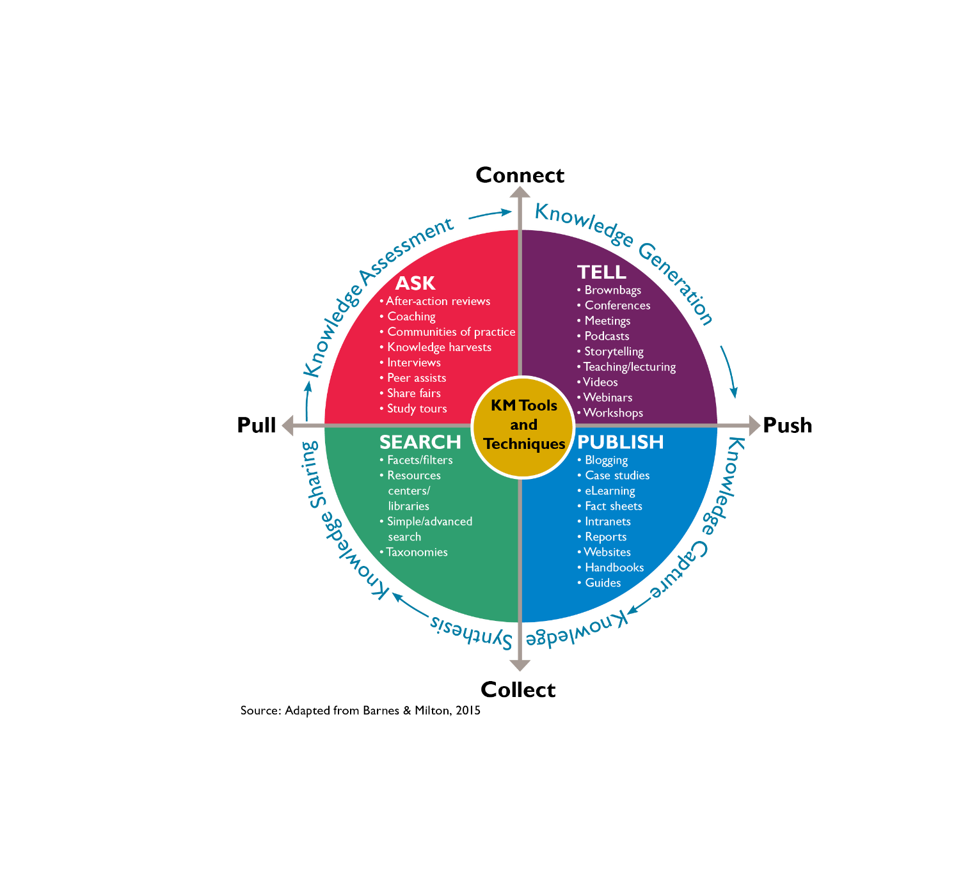
KM Tools and Techniques
Notes:
KM Tools/Techniques: What Activities Will You Conduct to Reach Your KM Objectives?
Your strategy will contain specific KM approaches to help you meet your objectives and target specific audiences.
We will address this when we get to Step 3: Create and Iterate. As a preview, here is a useful framework for thinking about the KM approaches you might use to achieve your goal:
AXIS 1: “Collection and Connection”.
AXIS 2: “Push and Pull”. pushing knowledge to key audiences, and activities that enable audiences to pull the content they need.
Some of these approaches are low-tech (for example, face-to-face meetings) and others are higher-tech and require more infrastructure (for example, intranets, mobile phone applications). Be sure to keep in mind the needs of your program while determining what KM approach will be best.
TRAINER NOTE: Emphasize the importance of keeping the needs of the health program—and of the defined audiences— in mind when determining the most appropriate KM interventions. Also, be sure to emphasize the importance of choosing interventions that can help overcome identified barriers to change.
SOURCE: Adapted from: Barnes, S. and Milton, N. 2015. Designing A Successful KM Strategy: A Guide for Knowledge Management Professionals. Information Today, Inc., Medford, NJ.

Slide 14
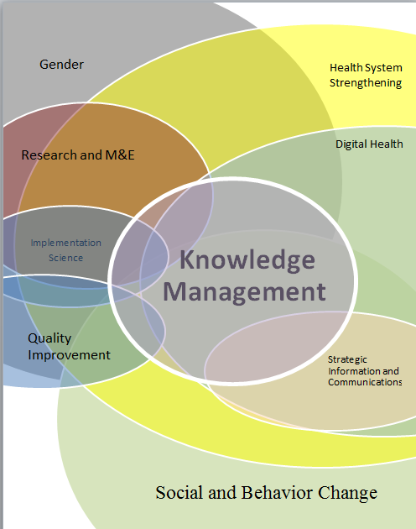
Where Does KM Fit?
Notes:
As you move forward, it is likely that your KM Strategy can be impacted by work guided by other strategic approaches. They present both opportunities and challenges.
This Venn diagram shows one way to look at how other approaches in health and development relate to KM.
Can you think of additional, explicit, links between another approach and KM?
Consider:
What can be borrowed from other approaches when developing your KM strategy
How other approaches complement KM
How other approaches might inhibit KM
TRAINER NOTE: If participants are interested, reference supplement that provides further information on KM’s intersection with other strategic approaches:
https://www.dropbox.com/s/wzwuilsd0j1ah4r/Supplement%20-%20Primer%20-%20KM%E2%80%99s%20Intersection%20with%20other%20Strategic%20Approaches%20-%20NEED%20TO%20COMPLETE.docx?dl=0

Slide 15
Budget, Resources, and Timeline
The scope of your KM strategy will depend on your budget and timeframe.
What resources or opportunities can you leverage?
Consider opportunities to leverage internal human resources or that of local NGOs or other partners.
Will new funding be available?
Are there new staff expected to be hired?
Notes:
Now, a reality check: Do you have the time and resources to reach your objectives?
It is important to anticipate and plan for changes in budget and staffing. Keep in mind that as budget and staff change in your project your KM strategy will have to also change. It is also important to note that there will be limits when working within a project setting that has a predetermined budget.
There are also opportunities to leverage time and resources from other parts of your current team or anticipate changes, such as new funding or new hires. These are important chances to contribute to your project’s knowledge and information needs.
For example, you can bring in internal or partner M&E staff. If there is a new position, you can advocate for the right kind of competencies conducive to KM (in addition to requisite skills needed for that position), and you can make sure to be part of the key staff that new staff meet with during the induction process. This will be discussed more in Step 3.

Slide 16
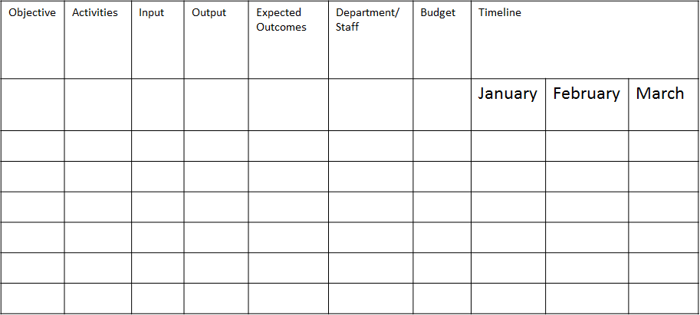
Implementation Guide and Timeline: Who Will Conduct the Activities and When?
Notes:
Like any strategy, you will need to have a working management tool, such as an implementation plan, to use throughout the implementation of your KM strategy
A template has been provided that can be adapted to your specific needs
Later in Step 2 we will have an opportunity to begin thinking about how to develop a KM implementation plan based on what you are learning and outputs you have developed for this training.
But, it does not end there. This is a working management tool for ongoing use.

Slide 17
M&E Plan: Success, Indicators, and Impact
Monitoring and evaluation plans typically describe:
The aspects of the KM intervention that will be monitored
How and how often the activities will be monitored
The research design for evaluating the overall impact of the KM intervention, if applicable
The indicators that will be measured
Notes:
To measure progress, identify challenges, and adapt the program accordingly, you will need a monitoring and evaluation plan.
Often, a M&E plan for KM is overlooked. However, the M&E plan can be a useful tool to show incremental progress. It can be useful when showing the reach of KM interventions.
It can also be used with M&E staff and project staff that might be unfamiliar with KM, but who may be familiar with performance monitoring.
The M&E plan is also a useful communication tool for staff reluctant about implementing activities without a process to monitoring progress and show change over time.

Slide 18
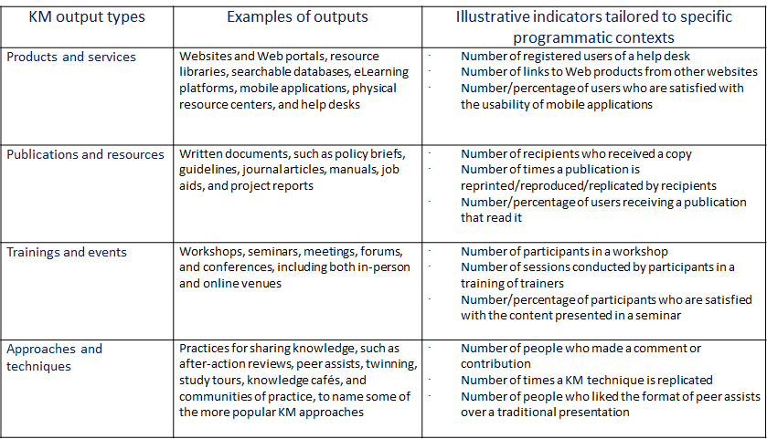
Illustrative Indicators
Notes:
Here are some illustrative indicators for four types of KM outputs.
We will be look at M&E for our KM activities in greater detail during Steps 4 and 5
The important takeaway for M&E of KM is to be specific and consistent about the indicators you are collecting toward your goals and not just whether an activity was implemented or not
Source: Ohkubo et al, 2015.

Slide 19
Launch the KM Strategy
Bring together stakeholders to kick-start the KM intervention
Review roles and responsibilities
Review the timeline
Review the tools, technologies, and resources that individuals will use to implement the strategy
Notes:
Once your KM plan has been created—ideally in a participatory manner with all relevant stakeholders to guarantee inclusion and ownership—it is important to bring together all the stakeholders again to kick-start the KM intervention.
At this time, you can review roles and responsibilities, the timeline, and the necessary tools, technologies, and resources that individuals will use. This will help ensure all stakeholders understand their own and each other’s roles and how their activities build on and fit with each other’s to contribute to the overall vision.
To ensure the success of your KM strategy, consider bringing together stakeholders across all levels of the work setting. This would include, for example, managers, support staff, ICT staff, relevant partners, and anyone else with a role in the KM intervention. Participation from the leadership of your health program or organization, in particular, will help ensure that the KM work is valued, understood, and supported.
TRAINER NOTE: If your participants want more information about launching a KM strategy, refer to the dissemination presentation in Step 1: Assess Needs

Slide 20
Plan for Sustainability
Involve stakeholders from the beginning
Work to influence ongoing behaviors
Consider community-based and organizational improvements
Mobilize groups with common interests
Connect leaders
Strengthen the capacity of staff
Document and disseminate your strategy
Notes:
Make your time and resource investments really count by including ideas and activities in your work that will have lasting—sustainable—value to the project.
Involve the community and other key stakeholders from the beginning so they “buy in” to the work and want to help make it successful.
Include activities and interventions in your strategy that influence ongoing behaviors, not just short-term actions.
Consider community-based as well as organizational improvements that could address root causes of problems.
Mobilize networks/groups with common interests to help support your intervention.
Connect leaders and provide training on how to develop and carry out effective policies that relate to your work.
Build the capacity of staff, partners, and communities to be able to carry on the work after the KM intervention.
Document and disseminate your strategy (or strategies) for others to use and adapt.

